Slide 1

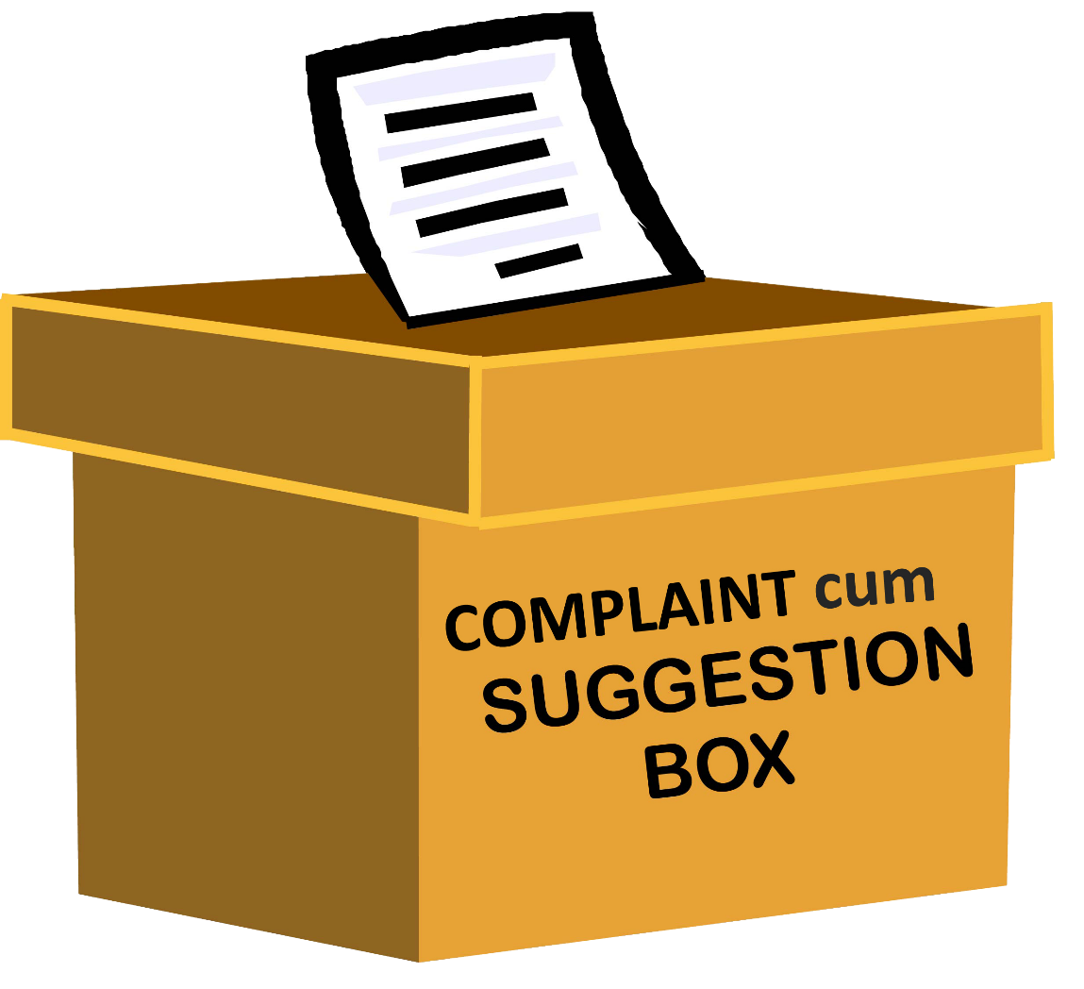
Log in
Sign in

Slide 2


Log in
User name
User Name
Password
User
Admin
Master Admin

Slide 3





Admin
Complaint booking
Complaint status
Notification
New service request

Slide 4


Complaint Registration
Complaint Subject
Print object creation or missing
Data base error
Report problem
Complaint Details
Complaint Department
Priority
maximum
Minimum
Normal
Sales
Billing
Purchase
Report
Pre-complaint status
Submit
Cancel

Slide 5
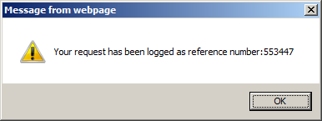
Accepted,

Slide 6
Notification
Sl.no | Name | complaint | priority | Department & Allocate to | Status
1 | Green health | Print object creation | Minimum | Vishnu | Allocated
2 | Baby Loft | Bill number missing | Maximum | Vishnu | Pending
3 | SDK | Report error | Normal | Vishnu | Holded
4 | LMNOPQ | couldn't find sales report
Minimum
Minimum
Maximum
Normal
Vishnu
Shinas
vineesh
🏠

Slide 7
Complaint status
Complaint Reference number
Check
Cancel

Slide 8
Ref.no | Company name | Complaint | Status
553447 | Green health | Print object creation | Pending
🏠

Slide 9
Service Request
Request Subject
Complaint Details
Submit
Cancel

Slide 10
Accepted,

Slide 11
User
Complaint booking
Complaint status
Notification
New service request

Slide 12
Complaint Registration
Complaint Subject
Print object creation or missing
Data base error
Report problem
Complaint Details
Complaint Department
Priority
maximum
Minimum
Normal
Sales
Billing
Purchase
Report
Pre-complaint status
Submit
Cancel

Slide 13
Accepted,

Slide 14
Notification
Sl.no | Name | Department & Allocate to | Status
1 | Print object creation | Vishnu | Allocated
2 | Bill number missing | Vishnu | Finished
3 | Report error | Vishnu | Finished
4 | couldn't find sales report | Vishnu | Finished
🏠

Slide 15
Complaint status
Complaint Reference number
Check
Cancel

Slide 16
Ref.no | Company name | Complaint | Status
553447 | Green health | Print object creation | Pending
🏠

Slide 17
Service Request
Request Subject
Complaint Details
Submit
Cancel

Slide 18
Accepted,

Slide 19
Master Admin
Complaint booking
Complaint status
Notification
New service request

Slide 20
Complaint Registration
Complaint Subject
Print object creation or missing
Data base error
Report problem
Complaint Details
Complaint Department
Priority
maximum
Minimum
Normal
Sales
Billing
Purchase
Report
Pre-complaint status
Submit
Cancel

Slide 21
Accepted,

Slide 22
Notification
Sl.no | Name | complaint | priority | Department & Allocate to | Status
1 | Green health | Print object creation | Minimum | Vishnu | Allocated
2 | Baby Loft | Bill number missing | Maximum | Vishnu | Pending
3 | SDK | Report error | Normal | Vishnu | Holded
4 | LMNOPQ | couldn't find sales report
🗑
🗑
🗑
Minimum
Minimum
Maximum
Normal
Vishnu
Shinas
vineesh
🏠

Slide 23
Complaint status
Complaint Reference number
Check
Cancel

Slide 24
Ref.no | Company name | Complaint | Status
553447 | Green health | Print object creation | Pending
🏠

Slide 25
Service Request
Request Subject
Complaint Details
Submit
Cancel

Slide 26
Accepted,

